Slide 1
Notes:
Leave this slide up while your guests arrive and seat themselves. You should have already switched everything on and have it working.

Slide 2
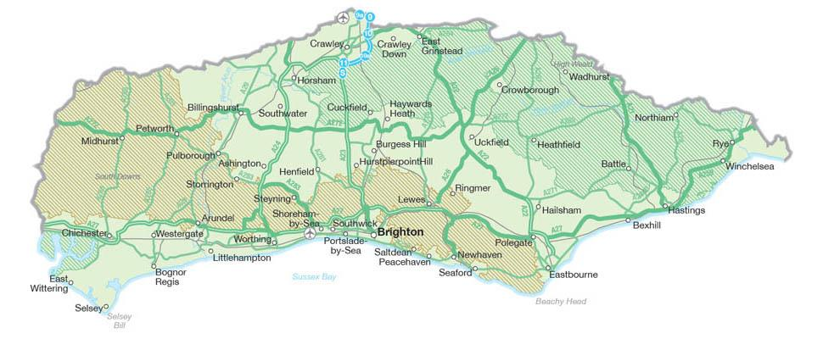
Where is your school?
Rye Harbour
The English Channel
Chichester Harbour
The Sussex coast is about 145 km long
= 12,000 buses!
Notes:
One way we are doing this is running Wild Beach sessions with local primary schools. Wild Beach is based on a fundamental respect for children and young people and for their capacity to instigate, test and maintain curiosity in the world around them. The sessions promote an understanding of the natural world through play and regular visits to a local coastal setting providing an opportunity to build a connection with nature.

Slide 3
© Ella Garrud
Notes:
Sandy Shores may appear lifeless at first but digging and sieving can reveal a wealth of interesting animal life
At first glance, it is easy to assume that sandy shores are devoid of wildlife. Nonetheless, animals here have developed several physical features and behaviours to survive in this environment. Animals are distributed on the shore according to how quickly the sediments dry out at low tide, which in turn is dependent on the particles’ sizes and height up the shore. Most animals are able to live by living beneath the surface of the sand, most hiding away as the tide drops, with many emerging as the tide comes in to feed. Some animals (mainly bivalves like clams) feed with tubes opening above the sand to suck in water and filter out food from the water. Some (including worms and brittle stars) gather food from the surface of the sand with tentacles. Others (like snails and crabs) emerge from the sand when underwater and search for food. Finally, some animals (including many worms) continuously burrow through the sand seeking prey or removing food from sand particles.

Slide 4
Animals that can be found on sandy beaches:
© Ella Garrud
Notes:
Sandy Shores may appear lifeless at first but digging and sieving can reveal a wealth of interesting animal life
At first glance, it is easy to assume that sandy shores are devoid of wildlife. Nonetheless, animals here have developed several physical features and behaviours to survive in this environment. Animals are distributed on the shore according to how quickly the sediments dry out at low tide, which in turn is dependent on the particles’ sizes and height up the shore. Most animals are able to live by living beneath the surface of the sand, most hiding away as the tide drops, with many emerging as the tide comes in to feed. Some animals (mainly bivalves like clams) feed with tubes opening above the sand to suck in water and filter out food from the water. Some (including worms and brittle stars) gather food from the surface of the sand with tentacles. Others (like snails and crabs) emerge from the sand when underwater and search for food. Finally, some animals (including many worms) continuously burrow through the sand seeking prey or removing food from sand particles.

Slide 5
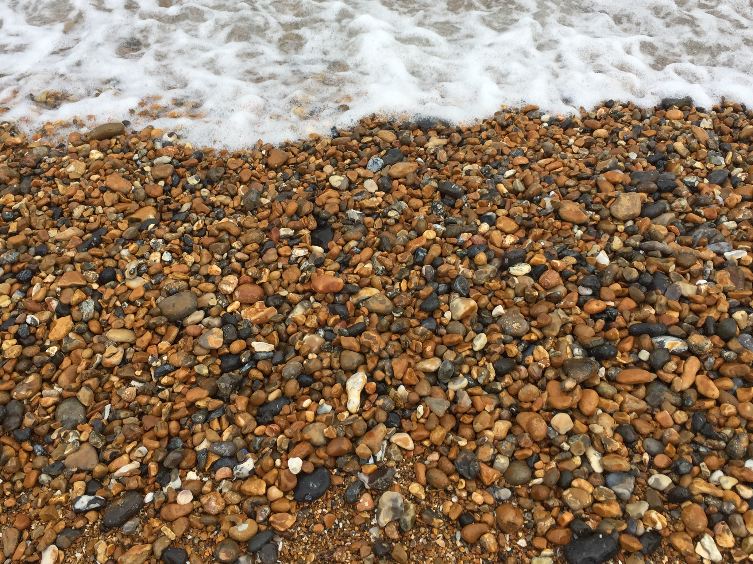
© Ella Garrud

Slide 6
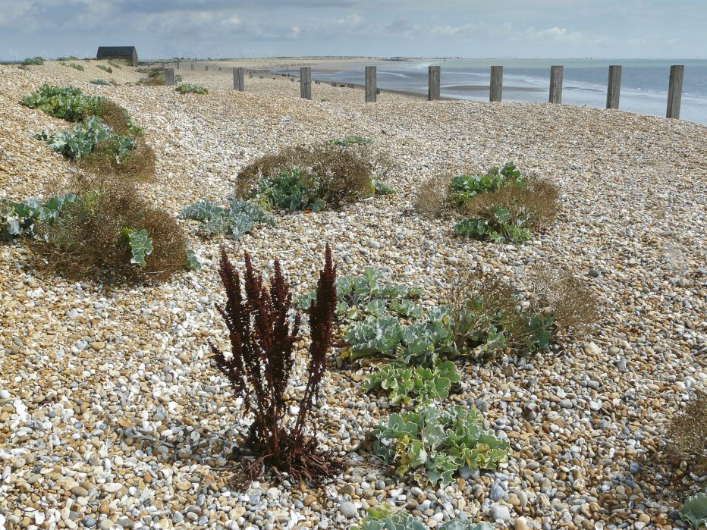
© BARRY YATES / Sussex Wildlife Trust.
Animals that can be found on shingle beaches:

Slide 7
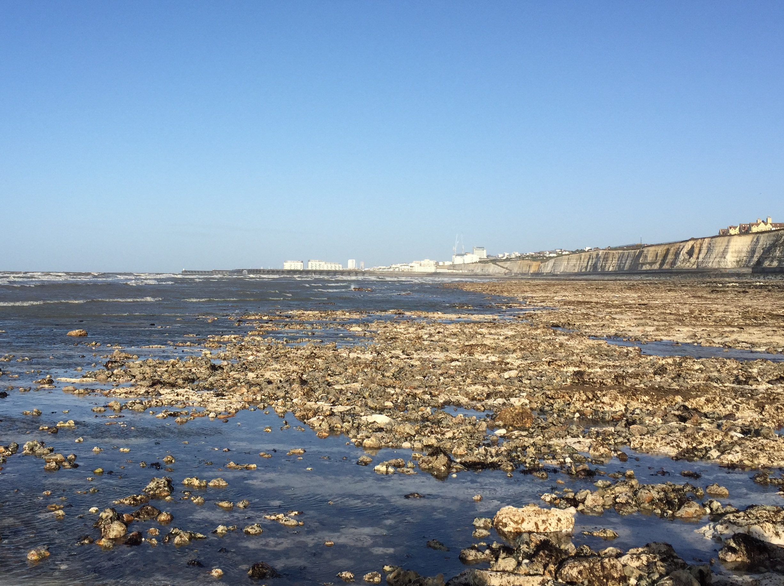
© Ella Garrud

Slide 8
Animals that can be found in rockpools:
© Ella Garrud

Slide 9
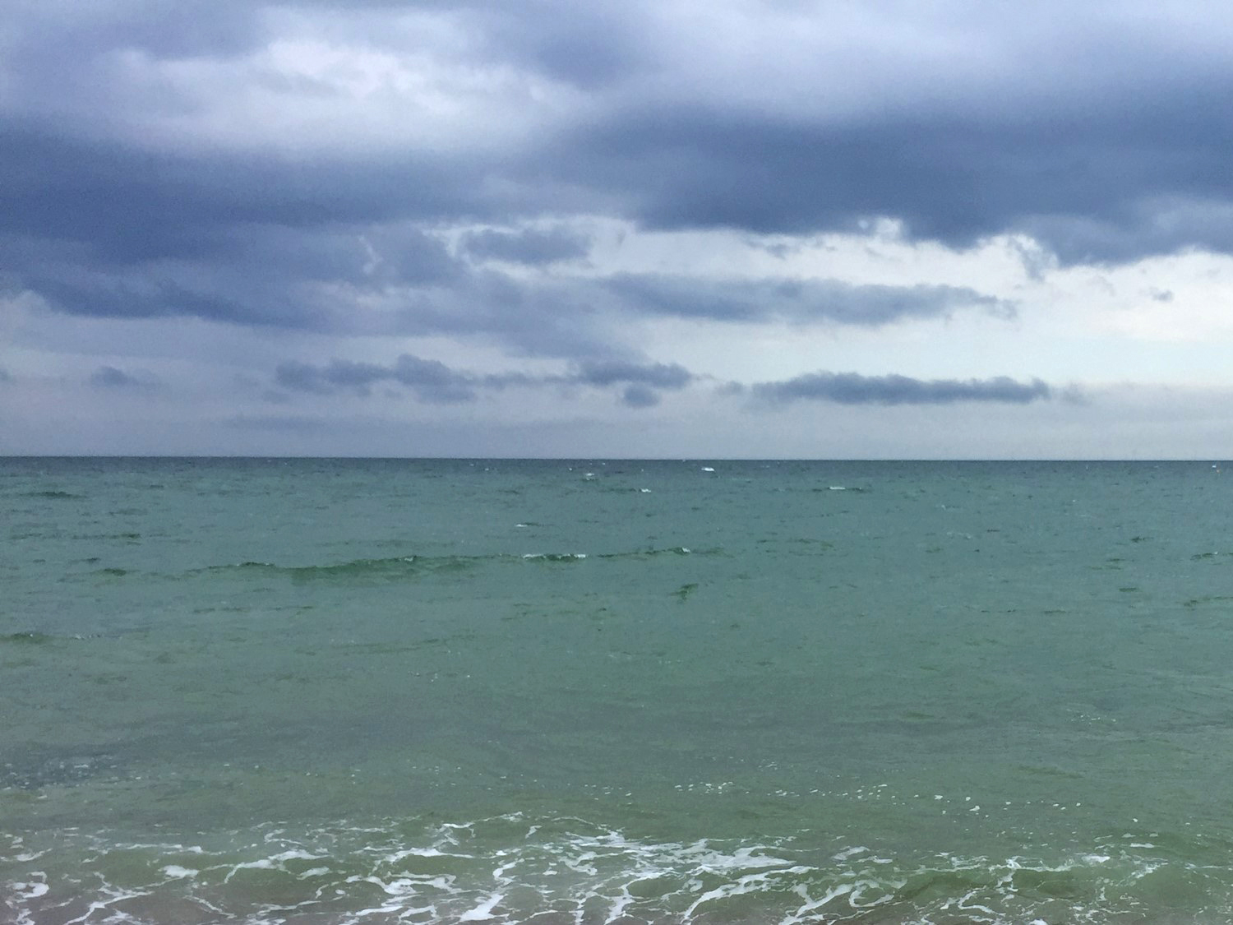
© Ella Garrud

Slide 10
Animals that can be found in the open ocean:

Slide 11
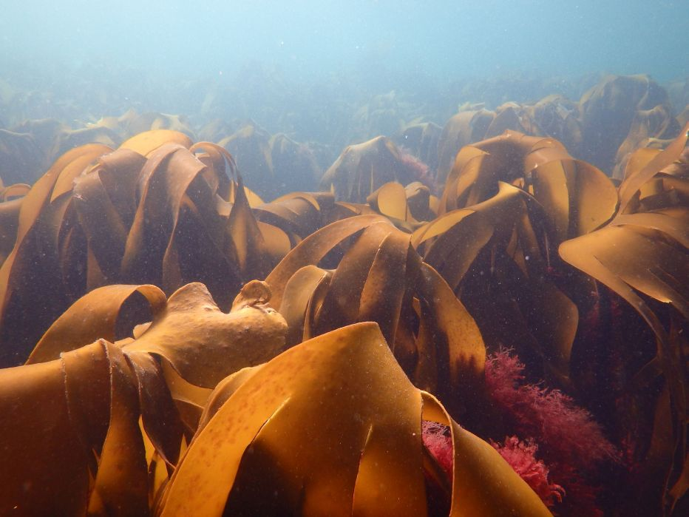
© DAN SMALE/Sussex Wildlife Trust.

Slide 12
Animals that can be found in kelp forests:
© DAN SMALE/Sussex Wildlife Trust.

Slide 13
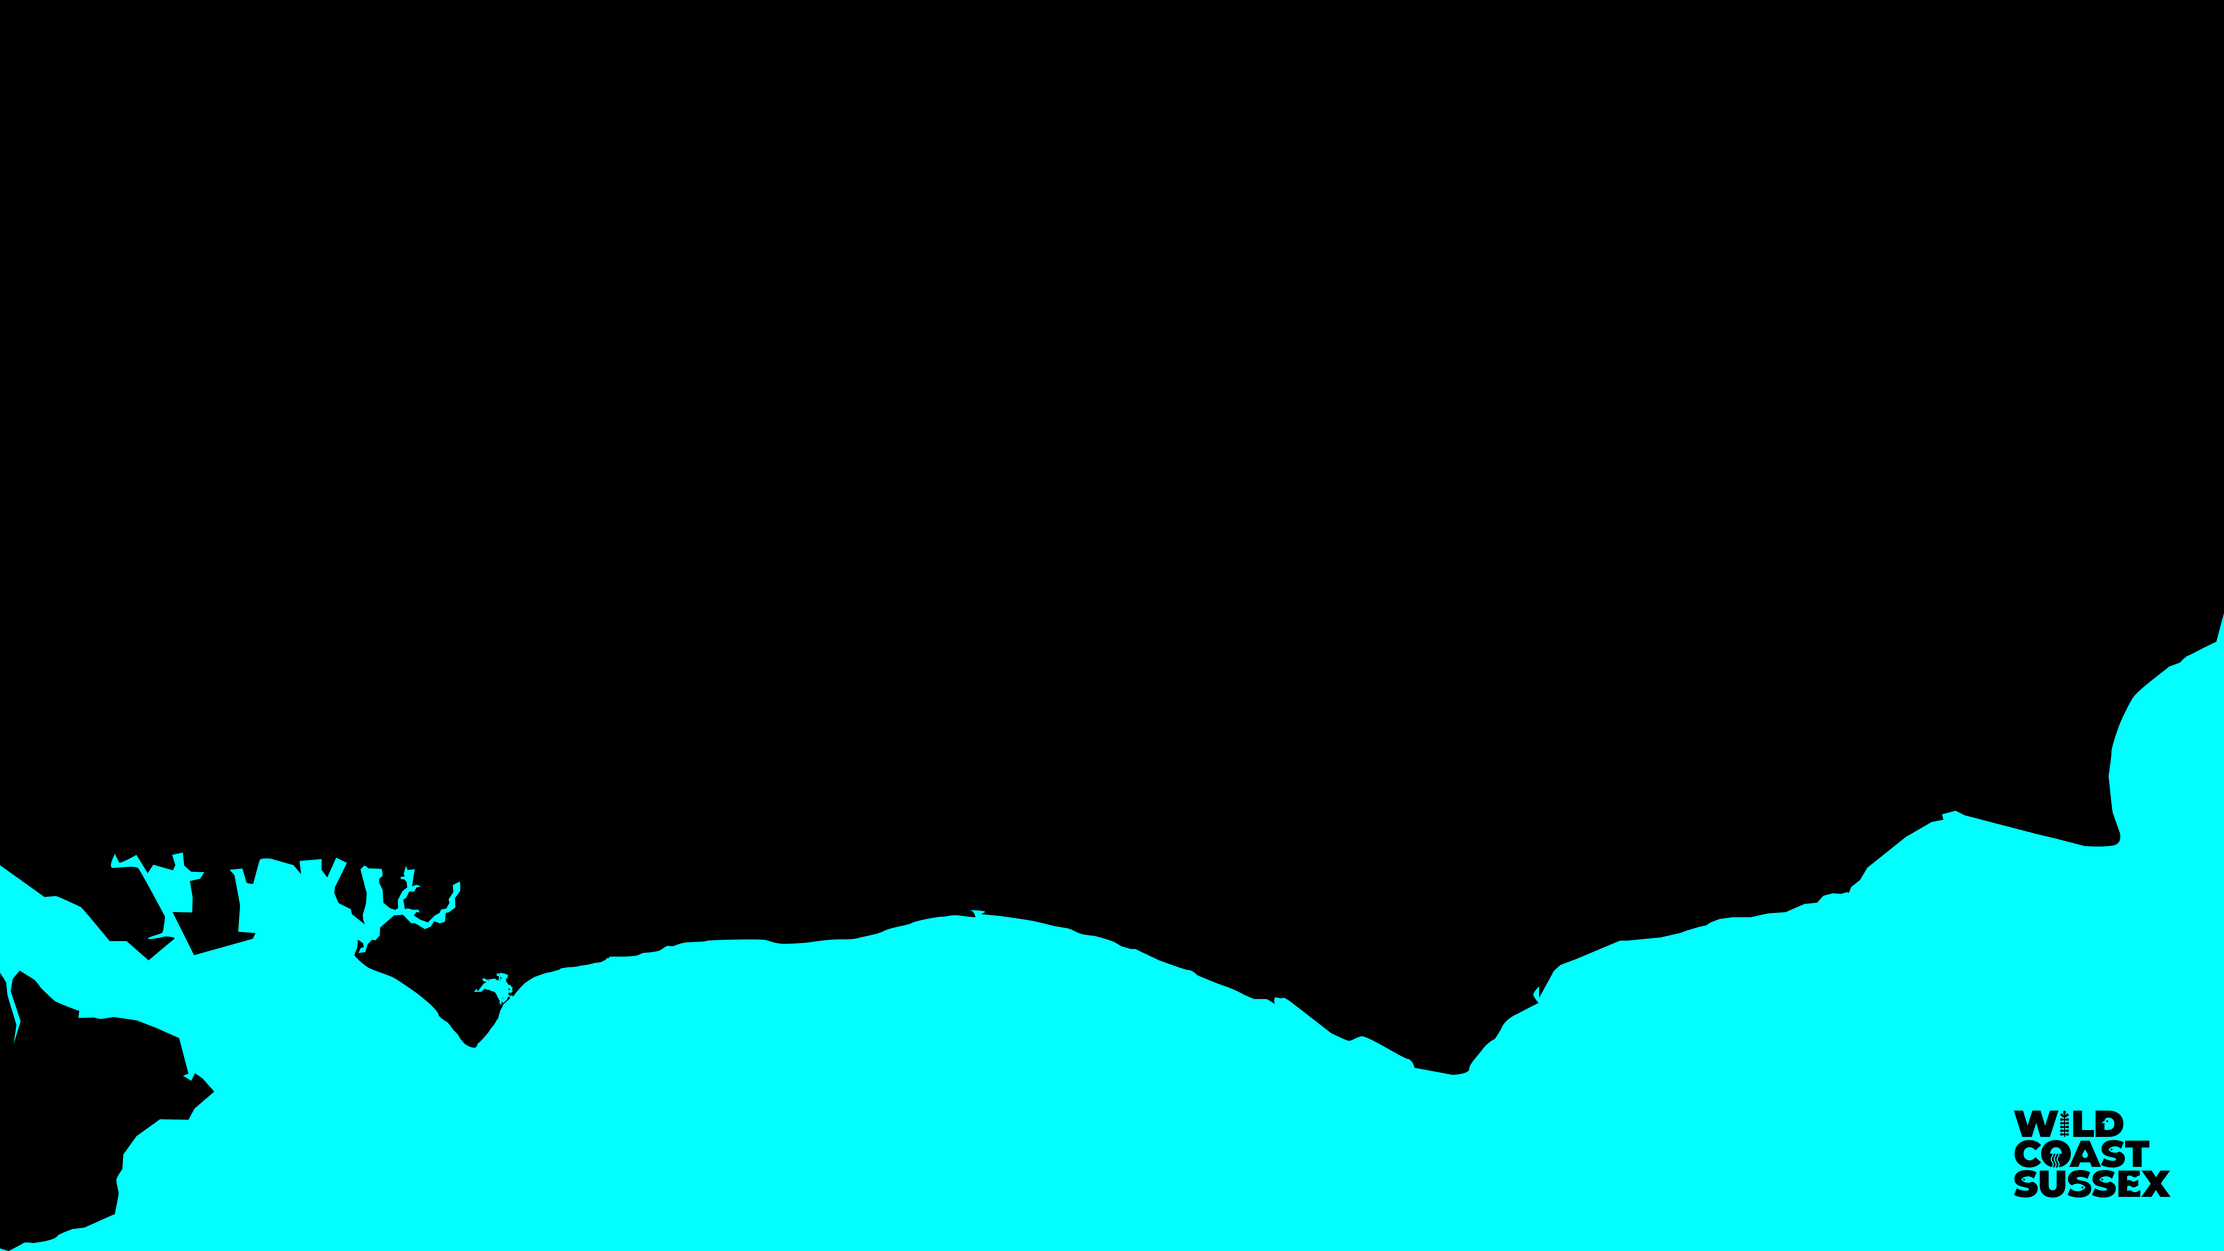

Slide 14
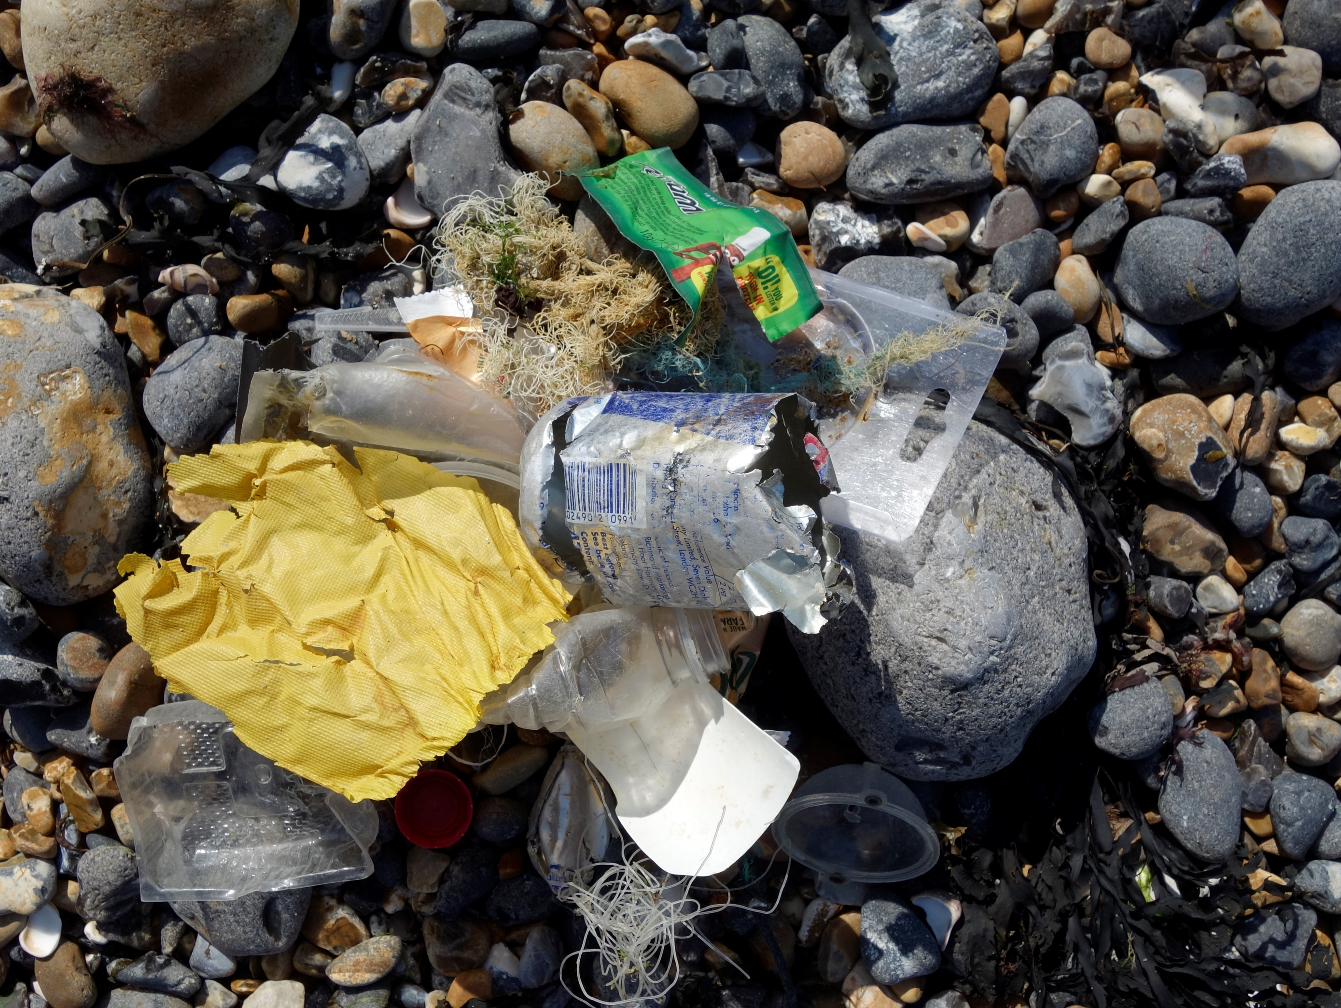
Some threats to the ocean are:

